Slide 1
PENTACORE BLOG

Slide 2
Pentacore Blogsite
Trained by
Vasanth Sai

Slide 3
Pentacore Blogsite
Team Members
Md. Hasibur Rahman(B-18)
Shima Akter(B-22)
Shamanur Chowdhuri(A-)
Sifat Lina Sultana(B-20)
Fahmida Poli(C-27)

Slide 4
Pentacore Blogsite
A blog is a discussion or informational site published on the World Wide Web
This blog delivers website authoring, administration tools designed to allow users to create and manage articles.

Slide 5
Features of Pentacore Blogsite
Automated Access control
Easily editable content
Document management
Content visualization
Less resource of the client computer

Slide 6
Pentacore Blogsite
The Blogsite Process
Implement by the following procedure, summarized in as follows:
being authorized for entry to panel
insert article
modify the document(update or delete)

Slide 7
Pentacore Blogsite
Tools
The technologies that may be used with Blogsite System include –
Database: MySQL.
Markup Language: HTML5
Programming Languuage: PHP, OOP PHP
Designing: Cascade Style Sheet
Bootstrap

Slide 8
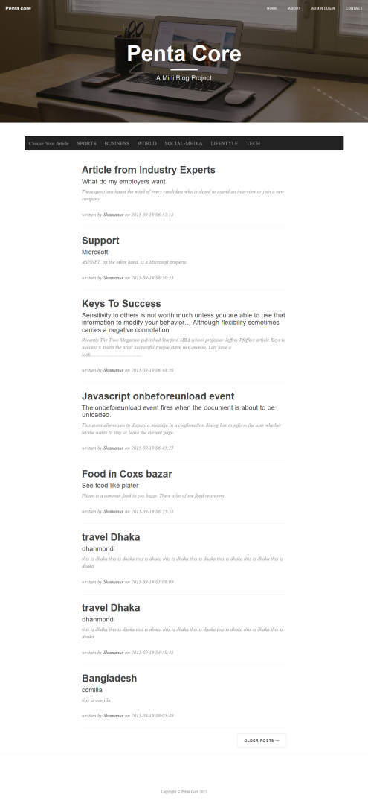
Frontend

Slide 9

Frontend

Slide 10
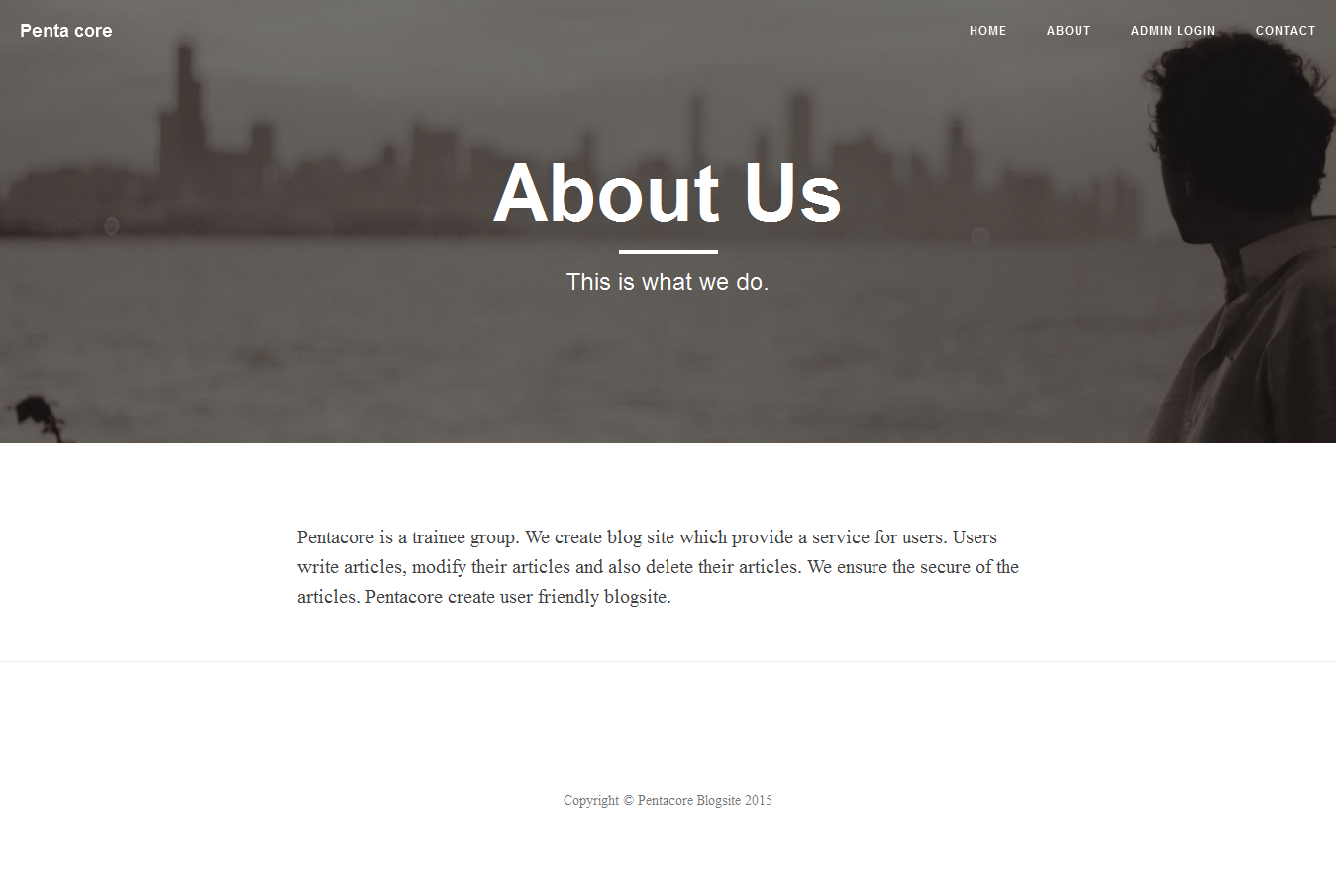
Frontend

Slide 11
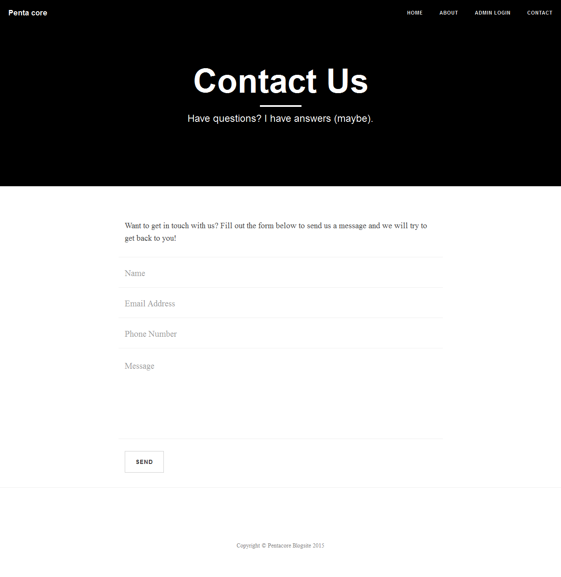
Frontend

Slide 12
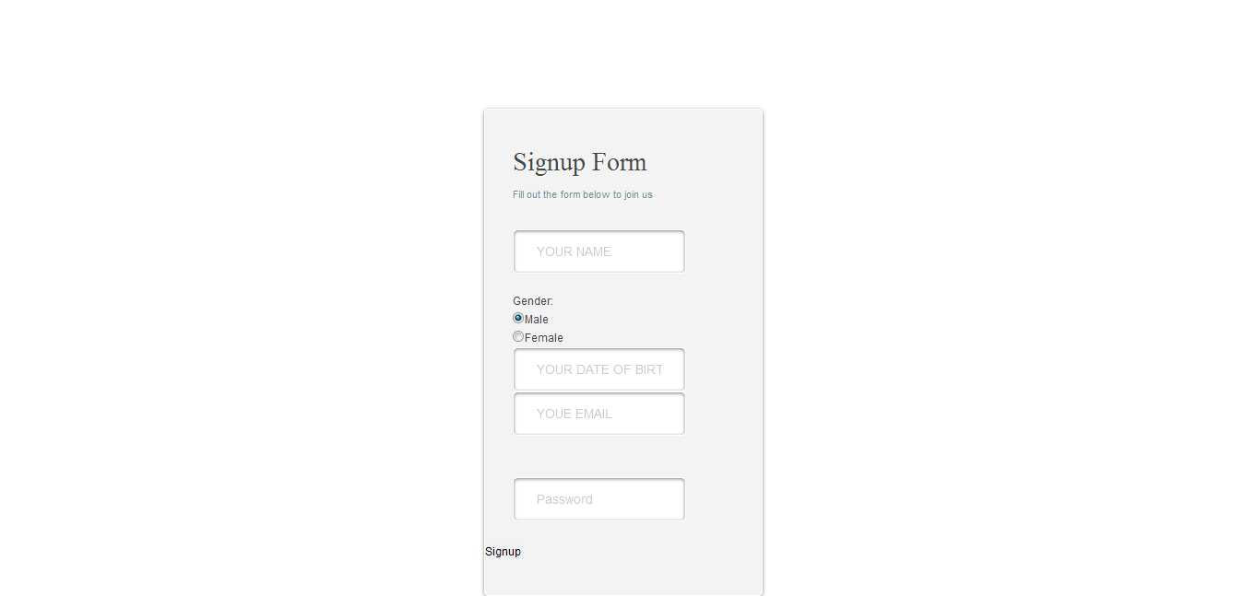
Admin

Slide 13
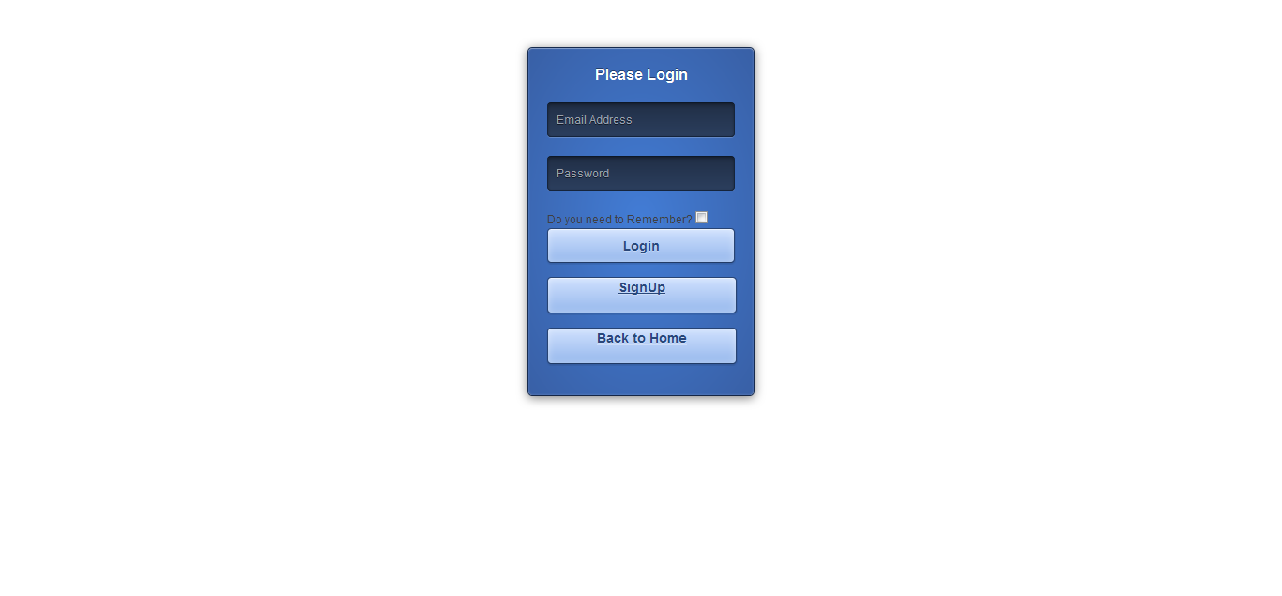
Admin

Slide 14
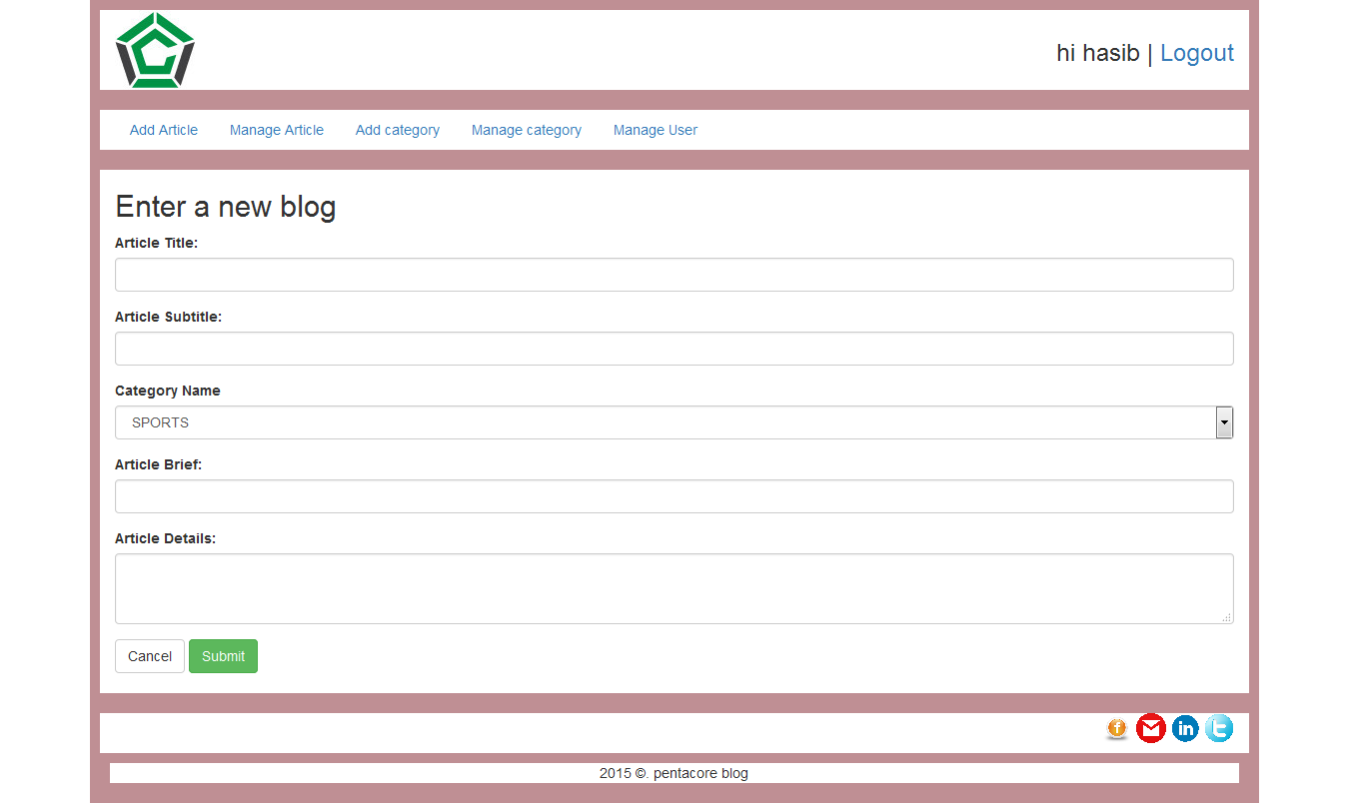
Admin

Slide 15
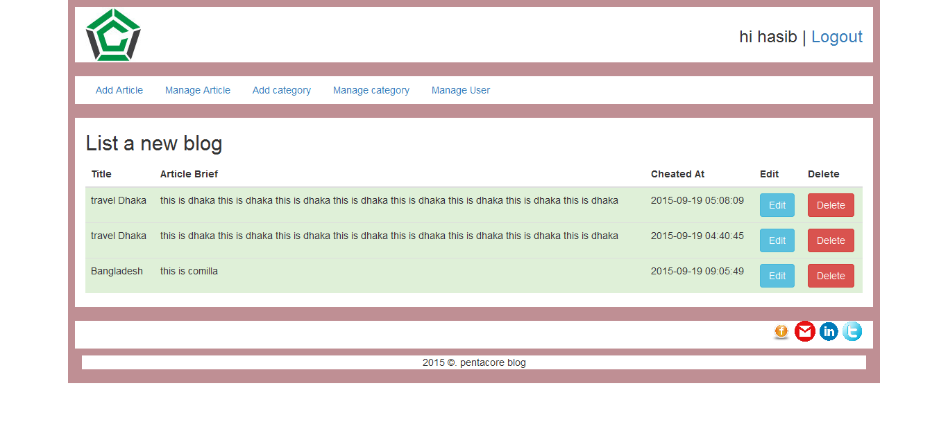
Admin

Slide 16
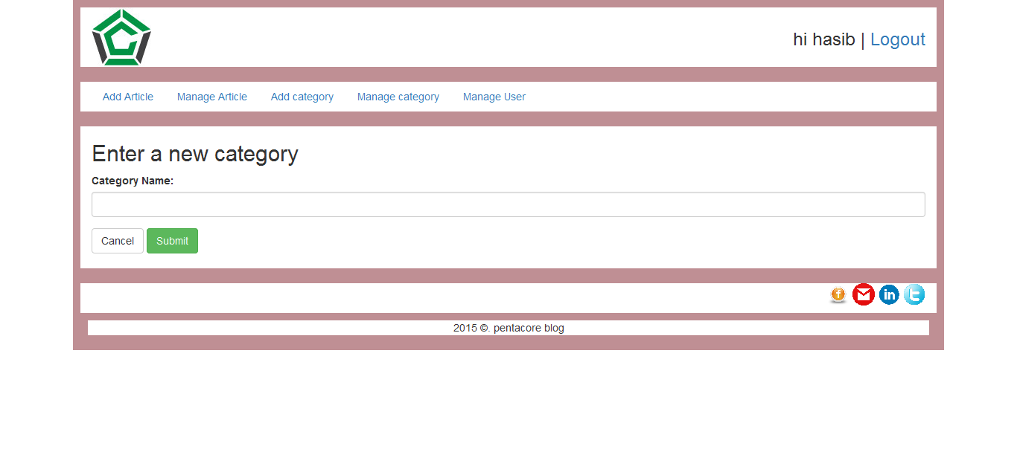
Admin

Slide 17
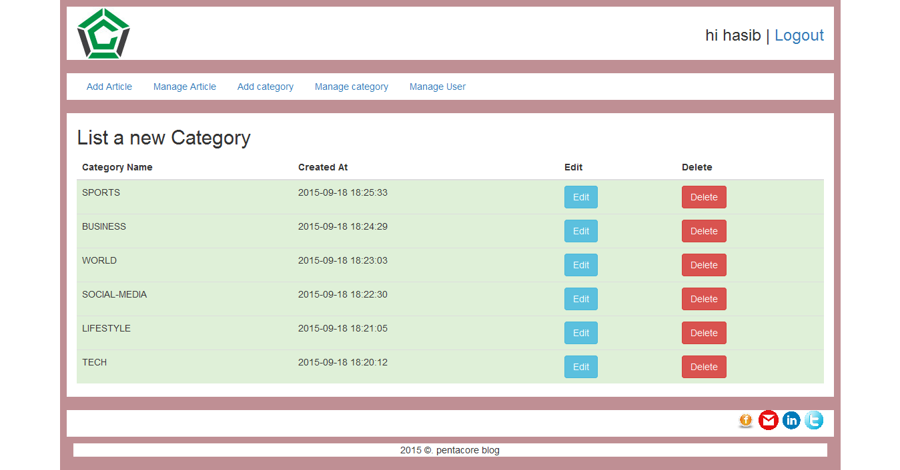
Admin

Slide 18
Pentacore Blogsite
THANK YOU

